Slide 1
F L O U R I S H
2016 Annual Report to the Community

Slide 2
Grow ● Thrive ● be productive ● Achieve
Notes:
What does it mean to “flourish” ? Look around you. We seem to be doing just that. We have been growing, thriving, producing, and achieving.
This meeting is a celebration of our flourishing. Today, let’s take a moment to be grateful for what we have been able to achieve as partners together. Tomorrow, we can take a look ahead at our ambitious list of goals. But today, let’s appreciate that we have flourished – as individuals, as organizations, and as a partnership.

Slide 3
M I S S I O N 2 0 0 9 – 2 0 1 6
Creating a healthier Shore

Slide 4
M I S S I O N 2 0 1 7 – 2 0 2 0
As a volunteer multi-sector partnership, ESHC’s mission is to develop an accountable care community using policy, systems and environmental change to improve the health and success of the Eastern Shore of Virginia

Slide 5
V I s I o n 2 0 0 9 – 2 0 1 6
We imagine a healthier Eastern Shore emerging from livable communities where children and adults have healthy eating choices at home, school, work, and in the community; walk, bicycle and swim safely; play or exercise outdoors, in neighborhood parks, trails, and open spaces; and enjoy a tobacco-free community.

Slide 6
V I s I o n 2 0 1 7 – 2 0 2 0
Well-being for all Eastern Shore of Virginia Residents
Notes:
Well-being is “a state characterized by health, happiness and prosperity.” Well-being is a valuable population health outcome measure because it reflects how well Eastern Shore of Virginia Residents perceive their life as going. Well-being is dependent on having good physical and emotional health. Social circumstances, financial resources, and community factors also play important roles.

Slide 7
F l o u r I s h
Notes:
How does a coalition’s work flourish?
A coalition’s work often follows a crooked line. Funding comes and goes. Social conditions, or our understanding of them, shift. Priorities emerge. Partners leave and expertise gaps occur. New partners join and like sand shifting from tidal flows, other channels emerge. Mission, vision, and framework align partnership work. Far from perfect, a coalition’s work is both messy and methodical; invisible and impactful.
And thus goes the work of Eastern Shore Healthy Communities (ESHC). Our essential partnership work occurs in smaller topic-driven work groups. Partners contemplate, strategize, and address specific issues, applying a policy, systems, and environmental change framework. Work groups report progress during monthly full partnership meetings.
Monthly meetings provide knowledge, influencing the information environment. Power of Partnership speakers, from a partner organizations or from organizations that have not yet become our partners, address work that contributes to a healthier Eastern Shore. In the resulting conversation, we embrace synergies, eliminate duplications, and create new partners, becoming a “partnership of partnerships”.
ESHC creates leaders. Our Chairs encourages leadership reflection at each meeting. With Eastern Shore Community College, ESHC hosts the Eastern Shore Youth Leadership Academy and in future, we will offer a similar adult training. We believe that everyone is born a leader. How good of a leader one becomes takes intention. Providing opportunities to learn and practice leadership skills is a crucial mission.
Individuals in effective and healthy partnerships flourish. They open their hearts, minds and arms. They grow, thrive, achieve and produce results.
In 2016 individuals, organizations and the Eastern Shore flourished. Much of this happened because of our effective, dedicated, and brilliant partners. Thanks to each one.

Slide 8
2 0 1 6
P A R T N E R S H I P
M E E T I N G S
Notes:
Let‘s review our partnership meetings for 2016, and once again thank our POP Talk speakers for sharing with us the work of their organization and engaging in a conversation on how together to create a better Eastern Shore. As we mention each speaker, if the speaker is here, please come forward to accept our thanks once again. We have a certificate of appreciation for you.

Slide 9
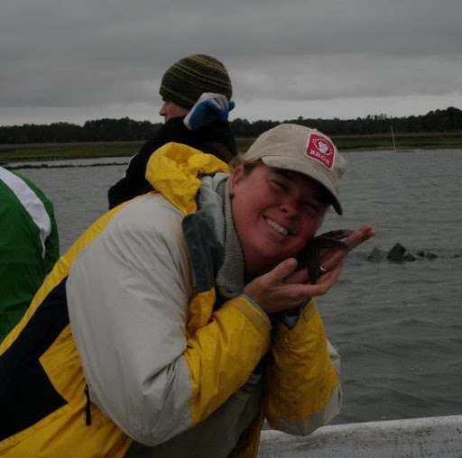
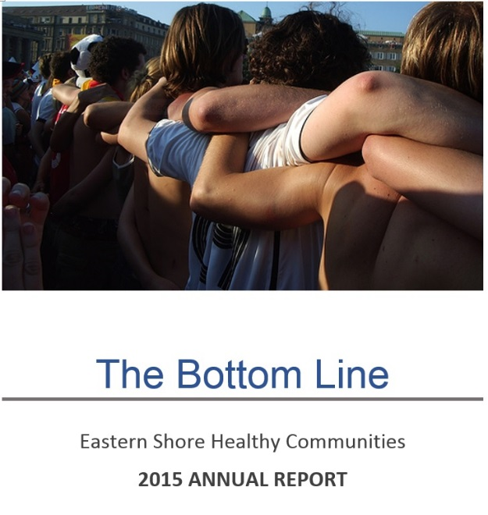
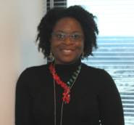
January
February
March
Margaret Van Clief
Adrienne McFadden, MD, JD
Notes:
In January, Margaret Van Clief, Outreach and Education Coordinator of The Nature Conservancy and Virginia Coast Reserve, shared the pleasures and responsibilities of taking care of lands and waters under their purview and invited us to walk the trails around Brownsville & beyond. Patrick Coady, Chair of the Northampton Ad Hock Emergency Medical Committee, summarized the state of Northampton County emergency medical services coverage as Riverside Shore Memorial Hospital moves north to Onley.
In February, the ESHC Annual Meeting theme, The Bottom Line, emphasized the importance of each partner in creating a healthier Eastern Shore. The meeting celebrated partners’ work during 2015. Color posters featured each work groups’ accomplishments, as Chairs presented certificates of appreciation to each work group member and Power of Partnership speakers. The meeting attracted 31 partners, including five guests from three Virginia Department of Health (VDH) districts, as well media representatives.
In March, the Virginia Department of Health Office of Minority Health and Health Equity Director, Dr. Adrienne McFadden, shared an overview of her office which works to counteract health disparities and optimize health equity across the state. Rural communities are a priority. Social epidemiologist, Rexford Anson-Dwamena, M.P.H., and co-developer of VDH’s Health Opportunity Index, presented the online mapping tool of community health influences, or social determinants of health, which Rex and his mentor Ken Studer developed and introduced six years ago.

Slide 10
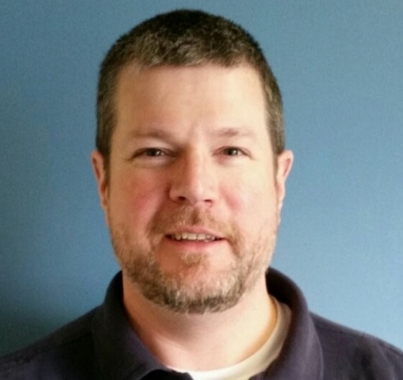
April
May
June
John Konkel, CIT Coordinator, Eastern Shore CSB
Notes:
In April local nursing students from Eastern Shore Community College and Thomas Nelson Community College, and their instructor, Terri Long, presented the Tobacco Control Use Project’s (TUCP) Store Alert Program survey. This was the nursing students’ fourth year conducting the evaluation. Using a report card approach, students reviewed visible outdoor signs placed on the grounds, near schools, above gas pumps, or above in store candy displays. These kinds of “in your face” advertising yield low store scores. Many stores in both Eastern Shore counties received failing scores. Much work remains to discourage tobacco use and eliminate signage aimed at children.
In May we heard from John Konkel, Coordinator of the Eastern Shore Community Services Board Crisis Intervention Team (CIT). John presented the work of this new entity which partners with Riverside Shore Memorial Hospital and law enforcement. He explained that CIT’s role is to keep people with mental illness safe; avoid punishing someone for an illness; conduct mental health evaluation for self-awareness, time and place orientation; help mentally ill persons with reorientation and stabilization; keep first responders safe; minimize re-traumatization; divert to appropriate treatment; connect with community resources; and avoid further hospitalization.
And in June we heard in-depth updates from all Work Group Chairs, who reported on their progress.

Slide 11
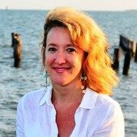
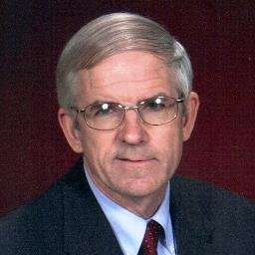
July
August
September
Donna Bozza
Citizens for a Better Eastern Shore
Scott Chandler
Led August Executive Committee Retreat
Notes:
In July we heard from Donna Bozza, Executive Director of Citizens for a Better Eastern Shore, as she explained that this three decades-old organization is dedicated to promoting balanced growth, enhancing the quality of life of all citizens, and preserving the Shore’s cultural and natural resources. They provide education, promote open government and citizen engagement. Membership dues, fundraising and their annual “Between the Waters” Bike Tour funds the group, and they offer a monthly newsletter.
August. In lieu of a monthly meeting, each August the Executive Committee spends a day in retreat to create or review the approved partnership strategy. This year the team met to put the pieces together to create an Accountable Care Community and a new strategic plan that supports an ACC. The Eastern Shore Plan for Well-Being 2017-2020 is a local adaptation of the Virginia Plan for Well-Being. An Accountable Care Community is an integrated community model that emphasizes health promotion and disease prevention; uses interprofessional and intersectoral teams to collaborate; creates an information technology infrastructure for shared surveillance and to create, monitor and rapidly share best practices. An ACC also engages in policy advocacy and analysis to institutionalize and facilitate success and sustainability.
Following the retreat, in September. Patti Kiger, our Executive Director, presented the Eastern Shore Plan for Well-Being 2017-2020, ESHC’s Strategic Plan which the Executive Committee worked on at their August retreat. The plan’s four aims align with the Virginia Department of Health’s plan of a similar name. They are: 1) The Eastern Shore of Virginia nurtures healthy, connected communities; 2) We insure a strong-start for children and youth; 3) We take preventive actions; and 4) We have a strong system of mental and physical health care. The final plan is currently undergoing review by many Eastern Shore organizations.

Slide 12
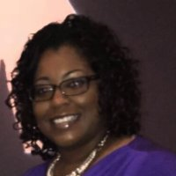
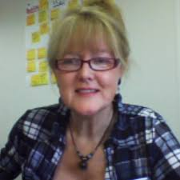
October
November
December
Ashley Gregory
VDH Tobacco Use Control Coordinator
Josephine Mooney
Eastern Shore Conservation and Redevelopment Council
Notes:
In October, our own Ashley Gregory, the VDH Tobacco Use and Control Project (TUCP) Coordinator presented the TUCP mission: “to provide comprehensive tobacco control, which empowers Virginia citizens to become full participants in healthy lifestyle choices”; and their goal: “to reduce premature death, disease, disability, and the economic burden related to tobacco use and/or exposure to second-hand smoke.” She explained the duties that she undertakes and VDH resources offered to organizations and individuals for technical assistance and education.
In November, we welcomed Josephine Mooney, Projects Director of the Eastern Shore Conservation and Redevelopment Council (ES RC&D) who told us about her organization’s work and its many projects that provide for the Eastern Shore’s conservation, preservation, improvement, and orderly development of natural resources and environmental values.
And in December, we took the month off to celebrate the holidays.

Slide 13
E X E C U T I V E
C O M M I T T E E
&
W O R K G R O U P S
Notes:
Full partnership meetings provide us with new information from community partners and work group updates. The most rigorous work of our partnership is done in our work groups. We’d like to summarize each work group’s achievements. When I announce your Work Group’s name, would the chair please come forward to help us hand out certificates of appreciation?

Slide 14
Executive Committee
Accomplishments
Defined an Eastern Shore Accountable Care Community – descriptions & measures
Drafted 2017-2020 Eastern Shore Plan for Well-Being
Created a “safe space” to examine & structure an integrated community health model
Created & continue to create “interprofessional” & intersectoral teams to insure all social & environmental health determinants are being addressed
Agreed to conduct one community health assessment instead of multiple assessments
Begun work on a shared IT infrastructure for shared surveillance, intervention & sharing best practices
Notes:
Speaking as co-chair of this group, I can tell you that since the 2015 August Executive Committee Retreat we have been flourishing: growing in their knowledge of how to work collaboratively to achieve a healthier and more successful Eastern Shore. In 2016 we added seven strategic partners and several new sectors to our membership. We defined an Accountable Eastern Shore Community and created the 2017-2020 Eastern Shore Plan for Well-Being, a blueprint for the future health and success of the Shore.
We ask the question: “Why do we spend more on health care than any other country and yet rank poorly on nearly every measure of health status?” and we have responded: we understand and embrace the fact that as a proportional contribution to premature death, 90% of the factors are non-medical.
In his landmark essay ”We can do better – Improving the health of the American people” S.A. Schroeder (2007) tells us that pathways to better health do not generally depend on better medical care, rather they depend on other domains: genetic predisposition, social circumstances, environmental exposures, and behavioral patterns. This is where the Executive Committee will focus their efforts.
Accomplishments include:
We’ve created a safe space in which an integrated model of community health and success can be examined and structured.
We’ve created Interprofessional and intersectoral teams that cut across businesses, professions, and communities to insure that all social and environmental health determinants are being addressed effectively to promote health in a self-empowering way.
We’ve enhanced planning, communication and follow-up. Plans to undertake one community health assessment instead of multiple assessments will reduce workload, expenses and duplication of effort and should yield useful data.
An information technology infrastructure is under development that will allow us to share data facilitating appropriate care and care transitions.
Moving forward, we plan to create a shared surveillance and a data warehouse to facilitate tracking health status, intervention outcomes, and share best practices.

Slide 15
Executive Committee
Funder
Virginia Foundation for Healthy Youth
Lead Agency
Eastern Virginia Medical School
Notes:
The Executive Committee’s work is funded by a grant from the Virginia Foundation for Healthy Youth. The lead agency, the organization that organizes the group, writes the agenda, minutes and supports the partners, is Eastern Virginia Medical School.

Slide 16
Executive Committee
Partners
Scott Chandler, co-chair Eastern Shore Health District | Erica Lawson Two-A District Court Service Unit
Linda Thomas-Glover, co-chair Eastern Shore Community College | David O. Matson Eastern Shore Health District
Pastor Gary Miller, vice chair St. Johns United Methodist Church | Steve Miner Accomack County Administration
Danny Vestal, past-chair YMCA Camp Silver Beach | Roberta Newman New Roads Consulting
Patti Kiger, executive director Eastern Virginia Medical School | Katie Nunez Northampton County Administration
Mozella Francis Northampton County Social Services Department | John Peterman Riverside Shore Memorial Hospital
Chris Holland Accomack County Public Schools | Nancy Stern Eastern Shore Rural Health System, Inc.
C. Edward Lawrence Northampton County Public Schools | MiMi Sedjat Eastern Shore Community Services Board
 | Vicki J. Weakley Accomack County Department of Social Services
Notes:
SCOTT: Linda, if you’ll help me hand out certificates of appreciation to those who were able to make it today:
LINDA: Okay, Scott, let me first thank you for serving as my co-chair of this organization for the past three years. And, “This Certificate of Appreciation is presented to you for your partnership in creating a healthier and more successful Eastern Shore by serving as Co-Chair for Eastern Shore Healthy Communities and its Executive Committee.”
SCOTT: Thank you, Linda. And allow me to thank you for serving as my co-chair these past three years and here is a certificate of appreciation for you for all that you have done to make this partnership flourish!
Continuing:
[Direction: Scott, read names and for those in the room, Linda hands out certificates]
Scott Chandler, ESHC Co-chair; Administrative Manager, Eastern Shore Health District
Linda Thomas-Glover, Ph.D., ESHC Co-chair; President, Eastern Shore Community College
Pastor Gary Miller, ESHC vice chair; Pastor, St. John’s United Methodist Church
Danny Vestal, ESHC Past Chair; Executive Director, YMCA Camp Silver Beach
Patti Kiger, ESHC Executive Director; Instructor, Department of Pediatrics, Eastern Virginia Medical School
Mozella Francis, Director, Northampton County Social Services Department
Chris Holland, Superintendent, Accomack County Public Schools
Charles Edward Lawrence, Superintendent, Northampton County Public Schools
Erica Lawson, Director, Two-A District Court Service Unit
David O. Matson, M.D., M.P.H., Director, Eastern Shore Health District
Steve Miner, Ed. D., Administrator, Accomack County
Roberta Newman, CEO, New Roads Consulting
Katie Nunez, Administrator, Northampton County
John Peterman, CEO, Riverside Shore Memorial Hospital
Nancy Stern, Chief Executive Officer, Eastern Shore Rural Health System, Inc.
MiMi Sedjat, LCSW, Executive Director, Eastern Shore Community Services Board
Vicki J. Weakley, MSW, Acting Director, Accomack County Department of Social Services

Slide 17
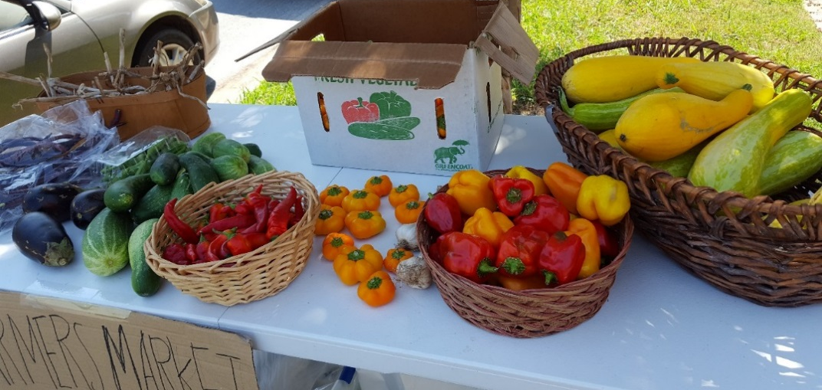
Chair
Ellen Pudney, Virginia Cooperative Extension
Food Access & Equity
Work Group
Notes:
Food Access & Equity Work Group. Would Chair Ellen Pudney please come forward to assist? Congratulations Ellen, to both you and your Work Group partners. You have worked hard this year and accomplished a great deal to be our newest work group. Please accept our thanks and this Certificate of Appreciation to you and Virginia Cooperative Extension for your work as chair of our newest work group, Food Access & Equity.
The March Food Summit revealed that Eastern Shore food insecurity was a barrier to achieving optimum health. As a result, the coalition formed a new work group to solve the existing issues related to food access and equity. The work group vision is to expand food access and equity to increase food security and improve Eastern Shore population health. Creating food equity means valuing everyone equally, addressing avoidable inequalities and injustices, and eliminating differences resulting from social, demographic, environmental, and geographic factors.
Since the work group’s first meeting in May 2016, partners have developed a strategic plan that will be woven into the larger partnership’s “Eastern Shore Plan for Well-Being.”

Slide 18
Food Access & Equity
Work Group
Accomplishments
Created a new system to manage & donate unsold produce from farmers’ markets to food pantries resulting in an addition 228 lbs. of donated produce over 3 months
In partnership with Eastern Shore Rural Health System, Inc.’s pediatrics team, working to add a food insecurity assessment to patient intake forms
Both Onancock & Cape Charles Farmers’ Markets have applied for incentive funds for patrons using SNAP/EBT benefits at their markets
Funding: None currently
Lead Agency: Virginia Cooperative Extension
Notes:
Accomplishments to date include:
Thanks to Work Group partner, Barb O’Hare, a system was developed and managed to donate unsold produce from the Cape Charles Farmers’ Market to the Cape Charles Food Pantry, resulting in an additional 228 pounds of donated produce to the pantry over three months. Charmin Horton, Eastern Shore Foodbank manager, helped to coordinate this effort and is working with Haydon Rochester to develop a similar system for the Onancock Market.
Work Group Chair Ellen Pudney developed a partnership with Eastern Shore Rural Health System, Inc.’s pediatrics team and asked them to add a food insecurity assessment to their patient intake forms. They are considering this.
Both the Onancock and Cape Charles Farmers’ Markets have applied for a grant to provide incentive funds to patrons using SNAP/EBT benefits at their markets.
The group does not currently have funding.
Thanks to Cooperative Service for serving as the lead agency for this group.

Slide 19
Food Access & Equity
Work Group
Partners
Work Group Partners
Ellen Pudney, Virginia Cooperative Extension, Chair
Barb O’Hare, Cape Charles Farmer’s Market
Bill O’Hare, O’Hare Data and Demographic Services, LLC
Stewart Lundy, Perennial Roots Farm
Haydon Rochester, The Onancock Market
Charmin Horton, Foodbank of Southeastern Virginia & the Eastern Shore
Keisha Elmandorf, Virginia Cooperative Extension
Joani Donohoe, Eastern Shore Health District
Patti Kiger, Eastern Virginia Medical School
Kimb Denny, Cape Charles Farmer’s Market
Wayne Burton, Accomack Department of Parks and Recreation
Sandy Beerends, Retired Physical Therapist
Notes:
Ellen, let’s thank the members of your work group with a certificate of appreciation.
Ellen Pudney, Virginia Cooperative Extension, Chair
Barb O’Hare, Cape Charles Farmer’s Market (Retired Demographer, U.S. Census Bureau)
Bill O’Hare, Former program officer, Annie E. Casey Foundation; U.S. Census Bureau Consultant; Children’s Leadership Council Consultant; and President of O’Hare Data and Demographic Services, LLC
Stewart Lundy, Perennial Roots Farm
Haydon Rochester, The Onancock Market
Charmin Horton, Foodbank of Southeastern Virginia and the Eastern Shore
Keisha Elmandorf, Virginia Cooperative Extension
Joani Donohoe, Eastern Shore Health District
Patti Kiger, Eastern Virginia Medical School
Kimb Denny, Cape Charles Farmer’s Market
Wayne Burton, Accomack Department of Parks and Recreation
Sandy Beerends, Retired Physical Therapist

Slide 20
Chair Joani Donohoe
Eastern Shore Health Department and Eastern Virginia Medical School
Healthy Mothers & Children Work Group
Notes:
Joani Donohoe, would you please come forward to help me thank and acknowledge the Healthy Mothers & Children Work Group?
This Work Group is focused on improving mother and child nutrition by strengthening community infrastructure. Well-fed mothers and children contribute to reducing chronic disease incidence. The project began in 2015 and concluded when its funding concluded in March 2016 with a successful Food Summit.
The Work Group created and implemented a community-driven plan to reduce chronic disease using policy, systems and environmental change strategies (PSE). This Work Group influenced two existing ESHC Work Groups: Healthy Options Restaurants (by providing funding for collateral materials and advertising) and Worksite and Faith Community Wellness Plans (by adding the Business Case for Breastfeeding to their Toolkit). It also spawned the Food Summit, numerous community resolutions, and the Food Access and Equity Work Group.

Slide 21
Accomplishments
Created spaces within Northampton & Accomack Health Departments for nursing mothers to express & store milk
Expanded WIC sign-up sites to day cares & Head Start Centers
Planned & executed the Eastern Shore Food Summit featuring Virginia’s First Lady Dorothy McAuliffe. Over 90 people attended
Created Food Insecurity Fact Sheets
Northampton & Accomack County Boards of Supervisors & Northampton County School Board have signed resolutions pledging to help resolve food insecurity
Launched the Food Access & Equity Work Group
Healthy Mothers & Children Work Group
Notes:
2016 accomplishments included:
Created spaces within the Northampton and Accomack counties Health Departments for nursing mothers to express and store milk. During the project, a federal policy went into effect requiring employers of a certain size to have such spaces for new mothers.
Expanded WIC sign-up sites to day cares and Head Start centers.
Held an Eastern Shore Food Summit, featuring Dorothy McAuliffe, Virginia’s First Lady, as keynote speaker. Ninety community members attended and heard ESVA estimates for food insecurity and its individual and community consequences.
Created a Food Insecurity Fact Sheet handout to explain food insecurity, its extent on the Eastern Shore, programs and resources available on the Shore, and new programs that can be added.
Northampton and Accomack County Boards of Supervisors, and the Northampton County School Board signed resolutions pledging partnership to end food insecurity on the Eastern Shore.
Launched the Food Access and Equity Workgroup to improve access and improve food equity within the community.

Slide 22
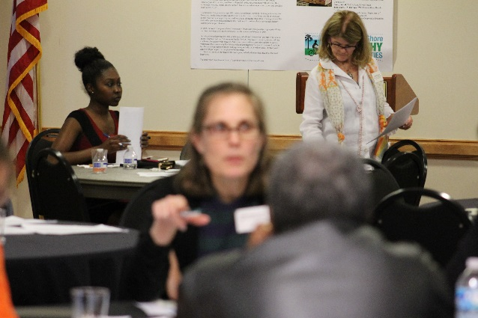
Healthy Mothers & Children Work Group
Funder Center for Disease Control & Prevention and the National Women, Infants & Children (WIC) Association
Lead Agency Eastern Shore Health Department
Partners
Joani Donohoe, Eastern Shore Health District (ESHD)
Raven Garris, ESHD
Joni White, ESHD
Truus Thomas-Wyatt, ESHD
Notes:
This work group was funded by the CDC and the WIC Association. The Health Department wrote the grant and served as the lead agency. And congratulations to the following people for their hard work:
Joani Donohoe
Raven Garris – who has moved to northern Virginia
Joni White – who recently retired from the Health Department
And Truus Thomas-Wyatt

Slide 23
Healthy Options Restaurants Work Group
Accomplishments
Two large outdoor signs promoting Healthy Options Restaurants greet residents & visitors on both north and south routes through ESVA.
ESHC’s website (eshealthycommunities.org) & Facebook page keep the community informed of Healthy Options partners.
A spring ad campaign promoted partner restaurants in the Eastern Shore Post, Eastern Shore News, & WESR-FM radio.
Many new Healthy Option items were added to partner restaurant menus.
Notes:
Joani, please stay with me as I thank you for chairing the Healthy Options Restaurants Work Group. This effort, more than any, has helped bring not only healthier foods on the menus of local Eastern Shore restaurants, but it has also created better name recognition for Eastern Shore Healthy Communities.
Healthy Options Restaurants is an example of environmental change. When our restaurants include healthy menu options, it shifts the communications environment.
In 2016, Healthy Options Restaurants flourished. Twelve locally owned restaurants have been with the program for the past three years and all have added new healthy menu items. Many of these restaurants have partnered with local aquaculture and produce farmers to feature fresh, Shore-grown seafood and produce to the delight of diners in quest of a tasty and nutritious meal. These restaurants are achieving success, being productive and supporting the local economy. We are grateful for their partnership in helping Eastern Shore residents understand the importance of a nutritious diet.
Accomplishments this year include:
Two large outdoor signs promoting Healthy Options Restaurants greet residents & visitors on both north and south routes through ESVA.
ESHC’s website (eshealthycommunities.org) & Facebook page keep the community informed of Healthy Options partners.
A spring ad campaign promoted partner restaurants in the Eastern Shore Post, Eastern Shore News, & WESR-FM radio.
Many new Healthy Option items were added to partner restaurant menus.

Slide 24
Funder: Virginia Foundation for Healthy Youth
Lead Agency: Eastern Shore Health Department
Work Group Partners:
Joani Donohoe, ESHD
Patti Kiger, EVMS
Restaurant Partners
Jean Mariner, Great Machipongo Clam Shack, Nassawadox
Andy Tiftikidis, Ocean Deli, Wallops Island
Sandra Fox, The Inn & Garden Café, Onancock
Blake Johnson, The Island House Restaurant, Wachapreague
Janet Hotcaveg, Onancock General Store--Janet’s Café
Franco Nocera, Little Italy Ristorante, Nassawadox
Hanh My, Saigon Village, Chincoteague
“Johnny Mo” Morrison, Mallards at the Wharf, Onancock
Deb & “Johnny Mo” Morrison, Mallards Sidewalk Café, Accomac
Roberta Romero, Cape Charles Coffee House
Terris Kennedy & Nancy James, Blarney Stone Pub, Onancock
Ron Wolff, Wolff’s Sandwich Shop, Atlantic
Notes:
Thank you Joani Donohoe and Patti Kiger, Work Group Partners. Also thanks to these Restaurant Partners:
Jean Mariner, Great Machipongo Clam Shack, Nassawadox
Andy Tiftikidis, Ocean Deli, Wallops Island
Sandra Fox, The Inn & Garden Café, Onancock
Blake Johnson, The Island House Restaurant, Wachapreague
Janet Hotcaveg, Onancock General Store--Janet’s Café
Franco Nocera, Little Italy Ristorante, Nassawadox
Hanh My, Saigon Village, Chincoteague
“Johnny Mo” Morrison, Mallards at the Wharf, Onancock
Deb & “Johnny Mo” Morrison, Mallards Sidewalk Café, Accomac
Roberta Romero, Cape Charles Coffee House
Terris Kennedy & Nancy James, Blarney Stone Pub, Onancock
Ron Wolff, Wolff’s Sandwich Shop, Atlantic

Slide 25
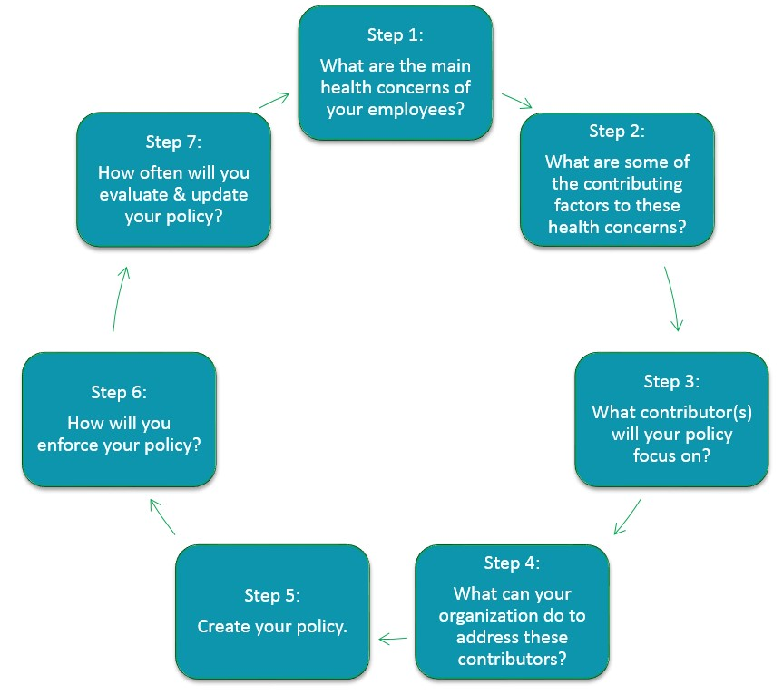
Worksite & Faith Community Wellness Policies
Work Group
7 Steps to Creating a Wellness Policy
Work Group Chair
Ashley Gregory
Virginia Department of Health
Notes:
Ashley Gregory, Chair of the Worksite & Faith Community Wellness Policies Work Group, is unable to be with us today. In her place, Amanda Thomas will come forward to receive our thank you for a Work Group and personal job well done.
And thank you for staying up here to help hand out certificates of appreciation to your work group. I believe two from your work group are missing today – but one more work group member is here.
This initiative encourages worksites, faith communities and other organizations to develop policies around healthy eating, physical activity, tobacco-free settings, and breastfeeding to reduce chronic diseases. In 2016 the work group continues to flourish with new members, new ideas, and new policies. The illustration on the screen represents the steps that work group members take to introduce a new organization to creating their own worksite or faith community wellness policy.
Accomplishments this year include:

Slide 26
Accomplishments
Worksite & Faith Community Wellness Policies
Work Group
Added evidence-based Business Case for Breastfeeding to tool kit to encourage worksites & faith communities to provide space & time for moms to pump & store milk
Working with Accomack County to develop/pilot employee biometric screening for evaluation. Implementation is expected in 2017.
17 organizations have adopted wellness policies
Accomack Sheriff’s Department | Northampton Sheriff’s Department
ANEC | Purdue
Arcadia Nursing Home | Quail Run
Blue Crab Bay Co. | Riverside Shore Memorial Hospital
Eastern Shore Rural Health System, Inc. | St. John’s United Methodist Church
Eastern Shore Community College | Tyson
Eastern Shore Health District | Eastern Shore Public Libraries
Eastern Shore CSB | 911 Group
Notes:
The evidence-based Business Case for Breastfeeding was added to encourage worksites and faith communities to provide breastfeeding moms with a private, clean and comfortable space and time during the work day to pump breastmilk for their nursing babies.
In all, 17 organizations have adopted Wellness Policies in various forms. The adoption of such policies contributes to the Eastern Shore of Virginia’s growing culture of health. Congratulations and thanks to these mission-based organizations for prioritizing health and wellness.
Accomack Sheriff’s Department
ANEC
Arcadia Nursing Home
Blue Crab Bay Co.
Eastern Shore Rural
Health System, Inc.
Eastern Shore
Community College
Eastern Shore Health District
Eastern Shore Community Services Board
Northampton Sheriff’s Department
Purdue
Quail Run
Riverside Shore Memorial Hospital
St. John’s United Methodist Church
Tyson
Eastern Shore Public Libraries (Accomack and Nassawadox)
911 Group

Slide 27
Worksite & Faith Community Wellness Policies
Work Group
Funder Virginia Foundation for Healthy Youth
Lead Agency Eastern Shore Health Department
Partners Ashley Gregory, VDH
George King, St. John’s UMC
Ellen Pudney, VA Cooperative Extension
Amanda Thomas, Eastern Shore Rural Health System, Inc.
Notes:
This Work Group is funded by the Virginia Foundation for Healthy Youth. The lead agency is the Eastern Shore Health Department. Congratulations and thank you to the following partners:
Ashley Gregory, representing the Eastern Shore Health Departments;
George King, representing St. John’s United Methodist Church;
Ellen Pudney, representing the Cooperative Extension; and Amanda Thomas of Eastern Shore Rural Health System.
Special thanks to Reverend Gary Miller for being the first pastor to lead a faith community wellness policy effort….and so far, the only one. Let’s work hard on getting our faith communities to adopt wellness policies. We need more!

Slide 28
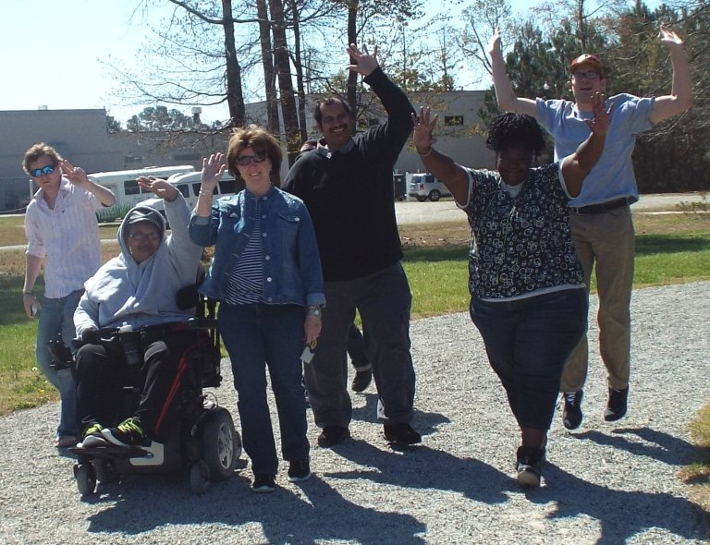
Walking Trails Work Group
Emma Fillebrown, Chair
Notes:
Emma Fillebrown, please join us to help us present the accomplishments for the Walking Trails Work Group
In 2012 Virginia Foundation for Healthy Youth (VFHY) funding allowed ESHC to offer mini-grants to Eastern Shore towns to create walking trails on existing sidewalks. Cape Charles, Nassawadox, Melfa, Wachapreague and Onancock were awarded signage and towns provided the location. In subsequent years VFHY funding enabled ESHC to offer exercise equipment to Northampton County for public use on county property and, in partnership with the YMCA, a walking track open to the public on YMCA property in Onley. In 2016 Emma Fillebrown, Outreach Coordinator for No Limits Eastern Shore, became Work Group Chair and along with her partners, made great things happen. A list of Work Group accomplishments follows:

Slide 29
Accomplishments
Walking Trails Work Group
Reached nearly 5,000 people with weekly blog posts featuring walking trails
Assessed 7 trails for use/accessibility with No Limits Eastern Shore’s Walking Trail Assessment Team. Find it on www.nolimitseasternshore.com/walking-trails/
Haydon Rochester walked and mapped all trails. Find on ESHC & NLES websites
Eastern Shore of Virginia Community Foundation funding, expect to see promotional brochures soon
Planning a “GeoTour” using the global application, “Geocaching.”
Notes:
Reached nearly 5,000 people with weekly blog posts featuring walking trails
Assessed 7 trails for use/accessibility with No Limits Eastern Shore’s Walking Trail Assessment Team. Find it on www.nolimitseasternshore.com/walking-trails/
Haydon Rochester walked and mapped all trails. Find on ESHC & NLES websites
Eastern Shore of Virginia Community Foundation funding, expect to see promotional brochures soon
Planning a “GeoTour” using the global application, “Geocaching.”

Slide 30
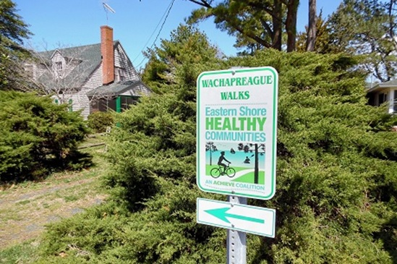
Funder The Eastern Shore of Virginia Community Foundation
Virginia Foundation for Healthy Youth
Lead Agency No Limits Eastern Shore
Work Group
Partners Emma Fillebrown, Chair
No Limits Eastern Shore
Margaret Van Clief
The Nature Conservancy & Virginia Coast Reserve
Haydon Rochester
Onancock Market
Notes:
The Work Group is funded by grants from The Eastern Shore of Virginia Community Foundation and the Virginia Foundation for Healthy Youth
Its lead agency is No Limits Eastern Shore.
And Emma, let’s thank your work group:
Margaret Van Clief
Haydon Rochester
And all your partners at No Limits Eastern Shore

Slide 31
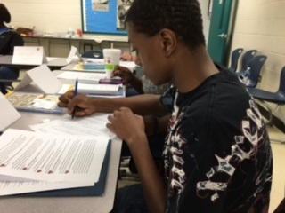
Youth Leadership Academy Work Group
Linda Thomas-Glover, Chair
2016 Scholars
Jenniyah Boggs, Senior, Arcadia High School
Briana Dennis, Freshman, Northampton High School
Isaac Gomez, Junior, Northampton High School
Imani Lee, Junior, Northampton High School
Briana Rogers, Senior, Nandua High School
William Rogers, Freshman, Nandua High School
Alexis Tucker, Junior, Arcadia High School
Quazhanik Upshur, Sophomore, Northampton High School
Madison Wessells, Sophomore, Broadwater Academy
Guest Speakers
Peter Lalor
Curtis W. Smith, A-N PDC
Nancy Stern, Eastern Shore Rural Health
Willie Randall, Edward Jones
Notes:
The Eastern Shore Youth Leadership Academy class of 2016 demonstrated that young people flourish when placed in supportive settings, are taught leadership skills, and given a goal. The goal: learn and use your leadership skills to develop a community project that improves Eastern Shore health and well-being. The resulting project was a description of how to: Use Joint Use Agreements for a Student After-school Physical Activity Program. Meeting for six Saturdays in the winter, these young leaders made great strides. Congratulations to this year’s Leadership Scholars. And Thank you to our speakers, Pete Laylor, Curt Smith, Nancy Stern, and Willie Randall.

Slide 32
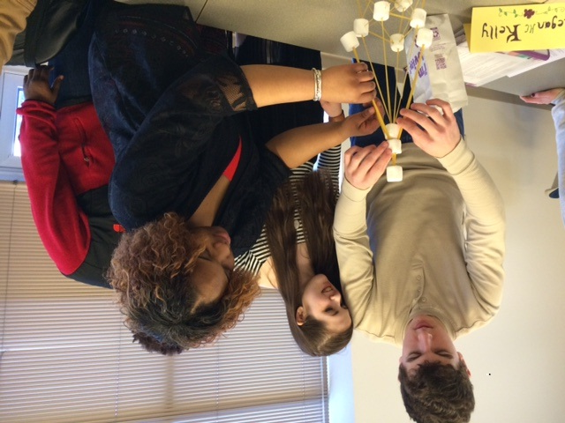
Youth Leadership Academy Work Group
Funder Virginia Foundation for Healthy Youth
Lead Agencies Eastern Shore Community College
Eastern Virginia Medical School
Work Group
Partners Linda Thomas-Glover, Chair, Eastern Shore Community College
Patti Kiger, Eastern Virginia Medical School
Aileen Joeckel, Blue Crab Bay Company
Scott Chandler, Eastern Shore Health
District
Notes:
Thanks to our funder, the Virginia Foundation for Healthy Youth; to our lead agencies, Eastern Shore Community College and Eastern Virginia Medical School; and to work group partners Linda Thomas-Glover, chair; Patti Kiger, Aileen Joeckel and Scott Chandler.

Slide 33
2 0 1 6
F O O D
S U M M I T
“How can our kids to be hungry for knowledge when they are just plain hungry.”
Dorothy McAuliffe, First Lady of Virginia
Notes:
Culminating a year-long Healthy Women and Children initiative, ESHC held its 2016 Food Summit. Ninety residents attended. Information researched and released during this event was intended to change the information environment. We learned that a significant number of Eastern Shore residents suffer from food insecurity. The result: we launched partnership efforts to address the issue.

Slide 34
2 0 1 6 F O O D S U M M I T
Accomplishments
Accomack & Northampton County Boards of Supervisors & Northampton County School Board signed resolutions pledging partnership to address food insecurity.
ESHC formed a Food Access & Equity Work Group to address food insecurity. This year a new system of providing leftover produce from farmers’ markets to the Food Bank was established.
More efforts are in the planning stages.

Slide 35
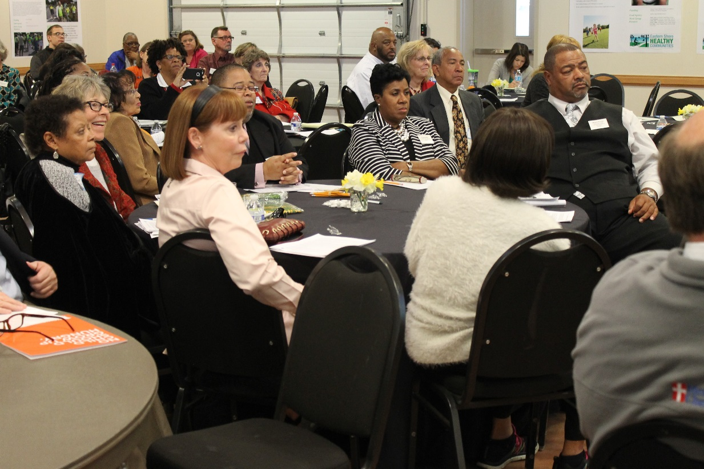
2 0 1 6 F O O D S U M M I T
Funders/Supporters CDC, WIC Association, Perdue
Lead Agency Eastern Shore Health Department (ESHD)
Work Group
Joani Donohoe, Eastern Shore Health Department
Raven Garris, ESHC
Patti Kiger, Eastern Virginia Medical School
Notes:
Culminating a year-long Healthy Women and Children initiative, ESHC held its 2016 Food Summit. Ninety residents attended. Information researched and released during this event was intended to change the information environment. We learned that a significant number of Eastern Shore residents suffer from food insecurity. The result: we launched partnership efforts to address the issue.

Slide 36
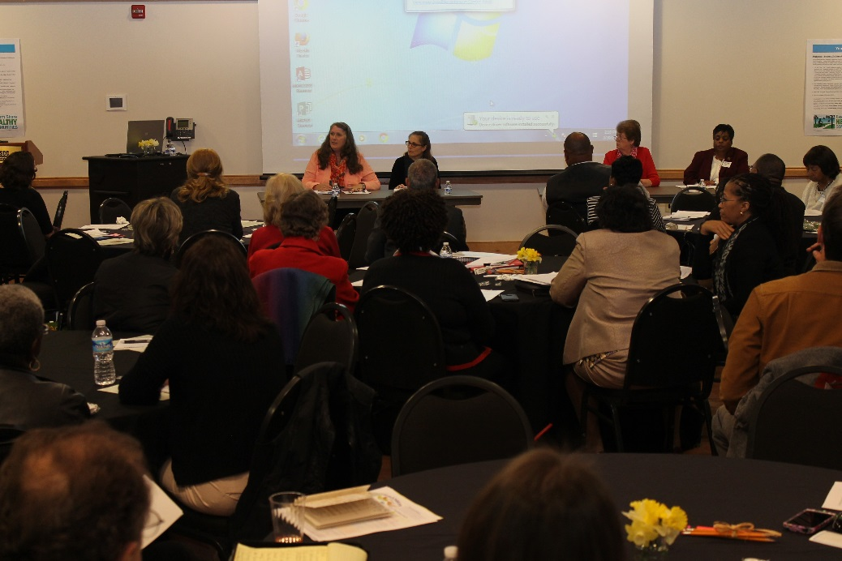
2 0 1 6 F O O D S U M M I T
Eastern Shore Food Insecurity Indicators
15% of Eastern Shore residents are food insecure
21% of Eastern Shore Children are food insecure
70% of public school students are in the free/reduced lunch program
Food insecurity is the condition in which access to adequate food is limited by a lack of money or other resources.
Notes:
Food insecurity is the condition in which access to adequate food is limited by a lack of money or other resources. Not to be confused with the term “hunger”, a state often experience a mealtime, food insecurity means someone can’t satisfy that feeling for themselves or their family – or fear that soon they won’t be able to put food on the table. This creates toxic stress for individuals – stress from which children don’t easily or ever recover.
One doesn’t have to be poor to be food insecure. A middle class person with no savings can lose a job and suddenly be without money to purchase food. Not all low-income people are food insecure. Money may be tight, but a low-income family connected to a larger family, church or caring neighbors can escape food insecurity because people who care about them share meals.
People who experience food insecurity tend to consume foods that are nutritionally poor, or when food is limited, individuals report overeating to compensate for periods of lack. These behaviors lead to obesity, diabetes, and other chronic physical and mental health conditions.
ESHC began its work in 2009 fighting obesity. At first it was thought that obesity came from undisciplined abundance. We now know that much of ESVA obesity comes from want.

Slide 37
P O S T S C R I P T
As we enter our ninth year of partnership, let’s envision the cycle of success.
Well-trained youth comprising tomorrow’s excellent work force are compelled to stay and flourish on the Eastern Shore of Virginia because of their employment potential and their ability to make a difference.
Population health is linked to economic health.
Stay true to PSE framework. Hone our intersectoral leadership skills. Evolve our understanding of health.
May you and your work continue to flourish.
Notes:
Health and wealth are inextricably linked. The Virginia Department of Health’s Health Opportunity Index provides evidence that ESVA’s biggest obstacle to health is jobs.
We often talk about breaking the cycle of poverty. With 20 percent of our population, including 30 percent of our youth, living in poverty, breaking this cycle is an important conversation. As we enter our ninth year of partnership, let’s start talking about and envisioning the cycle of success. Imagine this: Well-trained youth comprising tomorrow’s excellent work force are compelled to stay and flourish on ESVA because of their employment potential and their ability to make a difference.
With the upcoming launch of ESHC’s 2017 Eastern Shore Plan for Well-Being, we will move our partnership towards a broader mission that envisions population health linked with ESVA economic success. This ambitious undertaking creates an “accountable care community”.
Thanks to partner accomplishments recorded in this Annual Report and during our seven previous years, much has been achieved. We now draw deep breath because the work ahead requires even more energy. We must stay true to our “policies, systems and environmental change” framework, hone our “intersectoral leadership” skills, and evolve in our understanding of health.
Best wishes to all engaged in this effort. May both you and your work continue to flourish.

Slide 38
By the way…..have we said
T H A N K Y O U
Now on to 2017 !

